Slide 1
Software Requirement Engineering
The Features of a Product or Systems
Muhammad Nasir
m.nasir@iiu.edu.pk

Slide 2
Outline
Stakeholders and User Needs
Systems Features

Slide 3
Stakeholders and User Needs
Interestingly, when interviewed about their needs and requirements for a new system,
stakeholders typically describe neither of these things
at least not in terms of the definitions we've provided thus far

Slide 4
Stakeholders and User Needs
Stakeholders often tell you neither their real need ("I want to be able to slow this vehicle down as quickly as possible without skidding")
Nor the actual requirement for the system ("I must reduce sales order entry transaction processing time by 50 percent").

Slide 5
Stakeholders and User Needs
Instead, they describe what seems to be an abstraction somewhere between ("I need a new GUI-based order entry screen" and "I want a vehicle with ABS")

Slide 6
System Features
We call these high-level expressions of desired system behavior the features of a product or system.
These features are often not well defined and may even be in conflict with one another
—"I want increased order processing rates" and "I want to provide a far more user-friendly interface to help our new employees learn the system"

Slide 7
System Features: Real Need
but they are a representation of real needs, nevertheless.
What is happening in this discussion? In their minds, the stakeholders have already translated the real need (productivity or safety) into a
system behavior that they have reason to believe will solve the real need.

Slide 8
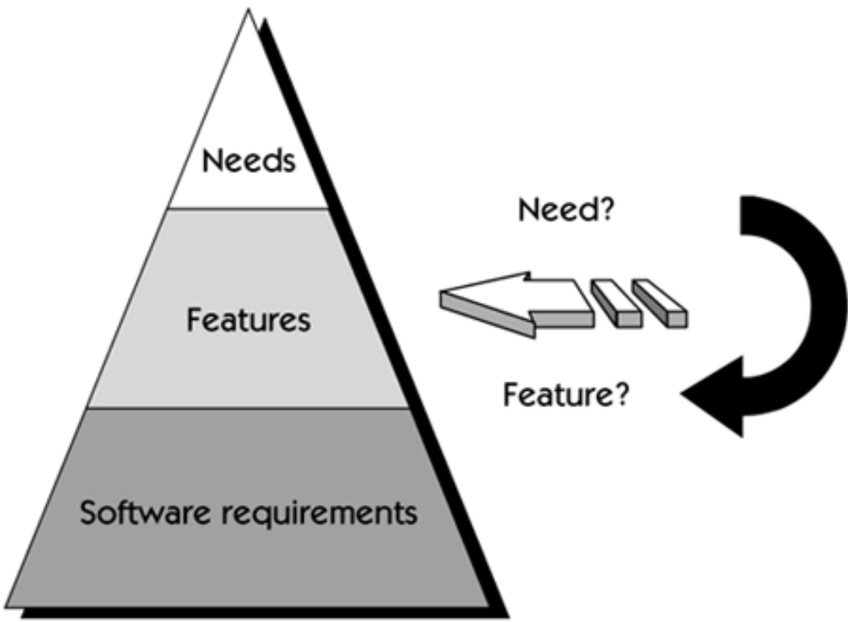
System Features

Slide 9
System Features: What to How...
In so doing, the what ("I need") has subtly shifted
to the how ("what I think the system should do to address this need").
This is not a bad thing since the user often has real expertise in the domain and real insight into the value of a prospective feature.

Slide 10
System Features
Also, because it is easy to discuss these features in natural language, to
document them, and to communicate them to others, they add tremendous richness to the requirements schema.

Slide 11
System Features: Limitations
However, there is a limitation to this discussion:
If the team leaves the discussion without an understanding of the need behind the feature, then there is a real risk.

Slide 12
System Features: Limitations
If the feature does not solve the real need for any reason, then the system may fail to meet the users' objectives
even though the implementation delivered the feature they requested.

Slide 13
System Feature: Definition
We define a feature as
“A service the system provides, to fulfill one or more stakeholders’ needs”
With this definition, users' features can't be too far from their needs, and we have a handy way to start to define the system.

Slide 14
System Features: Focus
Our focus in understanding user needs is on eliciting and organizing the needs and features of the proposed system.
Sometimes we’ll get all needs and no features.
Sometimes we'll get all features and no needs.
Sometimes we won't be able to tell them apart

Slide 15
System Features: Benefits
Features are easily expressed in natural language and consist of a short phrase
Features are also very helpful constructs for early product scope management and the related negotiation...
The statement of features does not entail a great deal of investment, and they are easy to describe and list.

Slide 16
System Features
To manage the complexity of the systems we are envisioning,
We recommend that, for any new system or for an increment to an existing system,
Elicitate maximum of only 25–99 features, with fewer than 50 preferred...

Slide 17
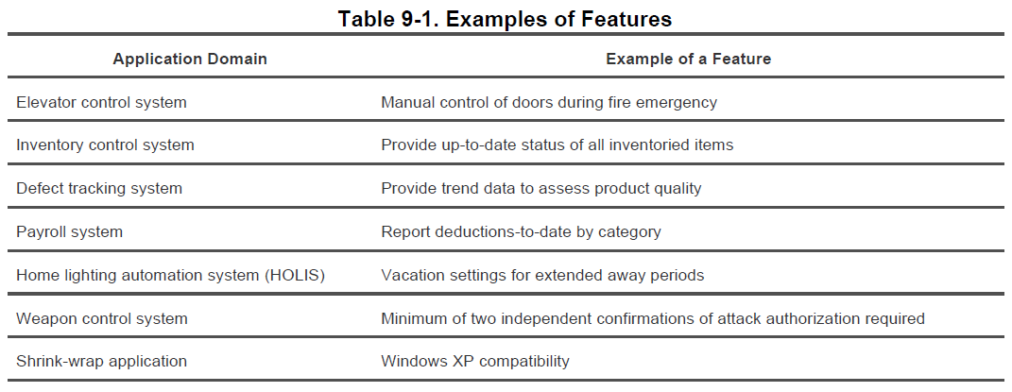
System Features: Examples

Slide 18
The End
Thanks for listening
Questions would be appreciated.

